Slide 1
Credit Card Fraud Detection using ctgan
REG ID | NAME
2300090154 | K SAI NITHEESH
2300080069 | A MEENA SAMEERA
2300080276 | N J SRINIVASA SAI
2300080351 | CH PARDHU SADHVIK

Slide 2
abstract
Problem Statement: Credit card fraud detection suffers from extreme class imbalance, where fraudulent transactions are very rare compared to legitimate ones, reducing the effectiveness of traditional machine learning models
Proposed Method: A Conditional Tabular GAN (CTGAN) is trained on real fraud samples to generate synthetic fraudulent transactions, which are combined with the original data to balance the dataset before training a Random Forest classifier.
Results & Impact: The augmented dataset improves fraud detection performance, as demonstrated by classification metrics and ROC-AUC score, showing that synthetic data generation effectively enhances minority class prediction while maintaining computational efficiency.

Slide 3
INTRODUCTION
The rapid growth of digital payment systems and online banking has significantly increased the volume of credit card transactions worldwide. While this advancement has improved financial convenience, it has also led to a rise in fraudulent activities. Credit card fraud detection has therefore become a critical task for financial institutions to minimize financial losses and ensure customer security. However, detecting fraudulent transactions remains challenging due to the highly imbalanced nature of real-world datasets, where fraudulent cases represent only a very small percentage of total transactions.

Slide 4
Data set Description
Data Description: The dataset used in this study is the Credit Card Fraud Detection dataset, which contains real-world credit card transactions made by European cardholders.
Dataset Overview
The dataset consists of 284,807 transactions.
Among these, only 492 transactions are fraudulent, making the dataset highly imbalanced.
Dataset Characteristics
All features are numerical.
No missing values are present.
Highly imbalanced class distribution.
Dataset : https://www.kaggle.com/datasets/mlg-ulb/creditcardfraud

Slide 5
feature Analysis
The credit card transaction dataset consists of anonymized features (V1–V28), along with Time, Amount, and the target variable Class. The features V1–V28 are principal component analysis (PCA) transformed variables that capture underlying transaction patterns while preserving confidentiality. The Time feature represents the elapsed time between transactions, and Amount indicates the monetary value of each transaction. Statistical analysis shows that most PCA features are centered around zero, while transaction amounts vary significantly between legitimate and fraudulent transactions. Additionally, the dataset is highly imbalanced, with fraudulent cases representing only a small fraction of total transactions, which necessitates the use of synthetic data generation techniques to improve model performance.

Slide 6
Methodology
Data collection:
The credit card dataset is loaded, cleaned, and reduced in size for faster training. The data is split into training and testing sets using stratified sampling to maintain class balance.
Fraud Data Extraction:
Fraudulent samples from the training set are separated to address the class imbalance problem.
Synthetic Data Generation (CTGAN):
A CTGAN model is trained only on real fraud samples to learn their distribution and generate synthetic fraudulent transactions.

Slide 7
Data Augmentation: The generated synthetic fraud samples are combined with the original training data to create a more balanced dataset.
Model Training A Random Forest classifier is trained on the augmented dataset to improve fraud detection performance..
Model Evaluation The model is evaluated using metrics such as classification report, confusion matrix, and ROC-AUC score on the test dataset.

Slide 8
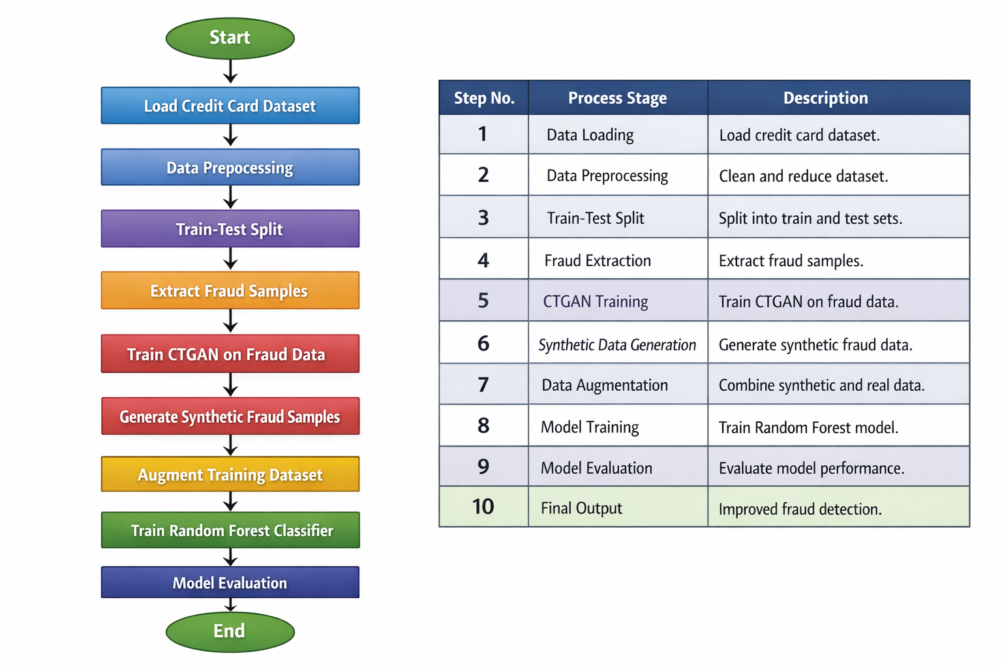
Flow chart

Slide 9
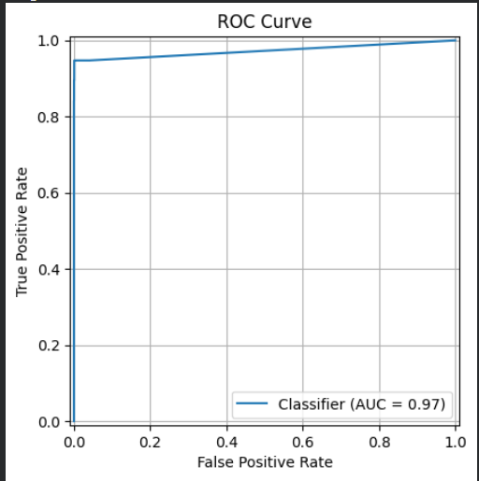
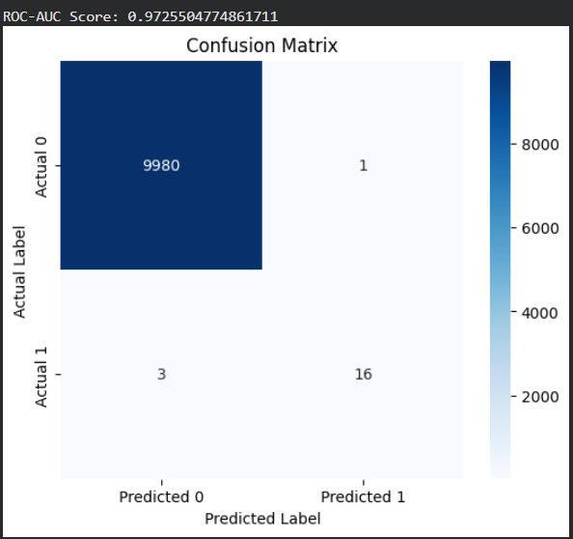
Results

Slide 10
conclusion
Credit card fraud detection is challenging due to extreme class imbalance in transaction datasets.
CTGAN effectively generates realistic synthetic fraud samples to improve minority class representation.
Augmenting the dataset with synthetic data enhances Random Forest model performance.
Evaluation metrics such as ROC-AUC and confusion matrix show improved fraud detection capability.
The proposed approach provides an efficient and practical solution for real-world fraud detection systems.
Model achieved around ~99% accuracy.

